Slide 1


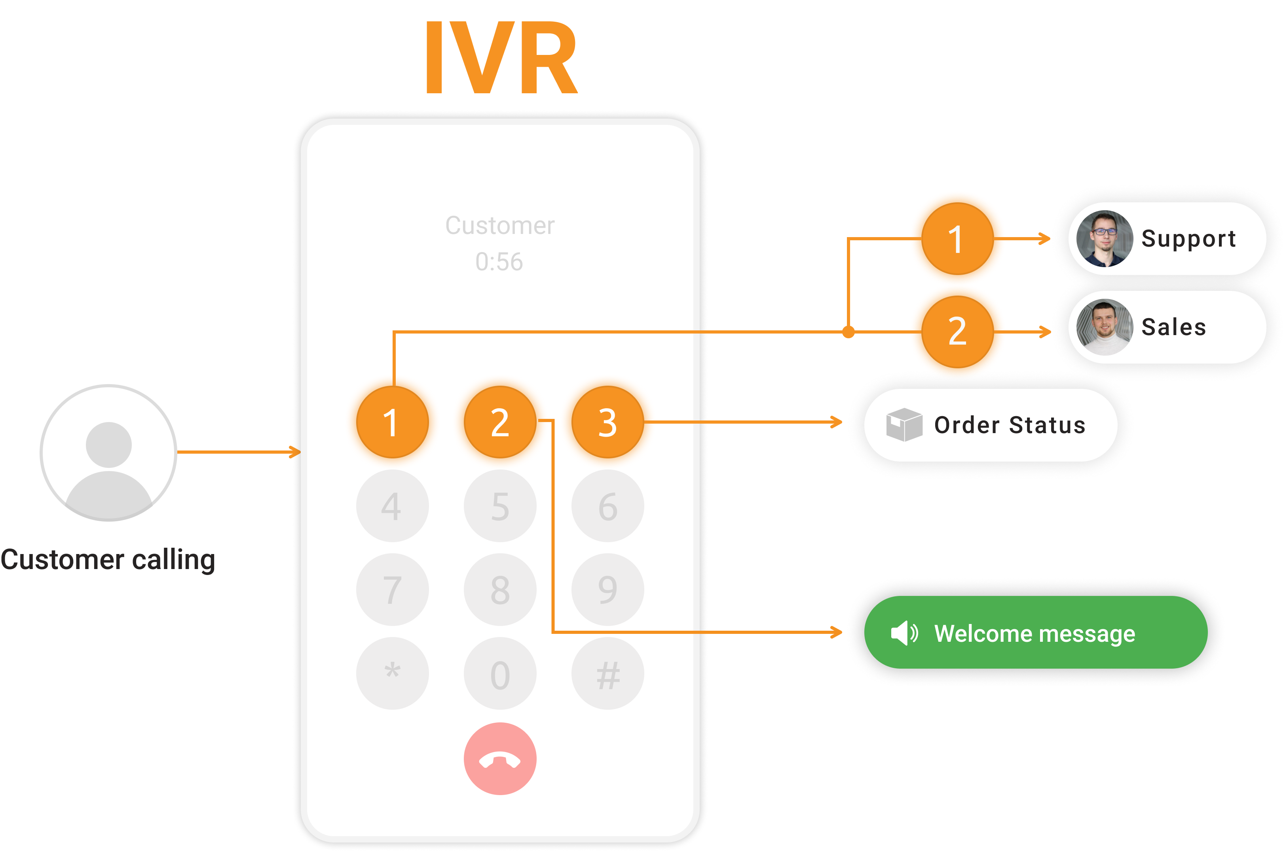
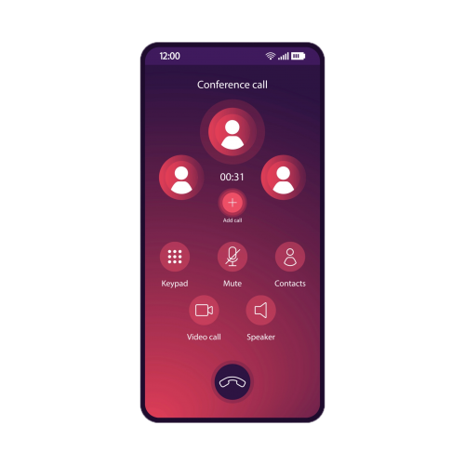


CampusTalk
Horieb Mesfun M80008142
Natnael Habtemicael M80008147
Siem Zeresenay M80008217
College of Technological Innovation, Zayed University
INTRODUCTION
PROJECT OBJECTIVES
Nowadays, calling someone with a Voice over Internet Protocol (VoIP) service is so common that most people no longer use traditional telephone lines or even digital phone networks. The ease of access and use of VoIP services, coupled with the no additional cost, make them more ubiquitous and necessary daily communication tools. As a result, most organizations use VoIP services as they only have to provide their employees with an Internet connection. However, some countries, such as the UAE and other Middle Eastern countries, prohibit such services. Moreover, organizations are expected to pay a hefty sum to use the enterprise/business version of most of these services. Moreover, such services provide these organization with a small room for customization and configuration.
In order to solve these problems, we came up with a VoIP platform that can significantly reduce the organizations’ financial burden concerning VoIP services and give an infinite space for customization and reconfiguration of said service. This is a service that an organization can implement with a minimal cost and workforce to accommodate its employees' needs. CampusTalk is a VoIP platform that is developed by a free and open-source framework, Asterisk, which offers a wide range of features and flexibility. CampusTalk offers various services, including VoIP calls, conference calls, voice mail, call queuing, and many more. It is deployed on a single server on Linux OS and designed to cater to the needs of a campus community, ensuring that communication is seamless and uninterrupted.
It addresses the existing issues of inefficient communication and collaboration across traditional telephony and PBX systems in organizations by providing a comprehensive VoIP communication platform that is tailored to the unique needs of the organization. By improving communication and collaboration, Campus Talk aims to increase productivity, reduce wait times, and streamline administrative tasks, ultimately improving the overall efficiency.
Developing VoIP platform with Asterisk:
Open-source software: free and open-source framework allows the organization to customize and configure the software to meet their specific needs.
Flexibility: to create a robust and flexible VoIP solution that enables organizations to communicate effectively and efficiently with their customers and employees.
Reliability: reliable communication platform to ensure that the platform has redundancy and failover mechanisms in place to prevent downtime or service interruptions.
Security: Communication platforms must be designed with strong security measures in place to protect sensitive data and prevent unauthorized access. This can include measures such as encryption, user authentication, and access controls.
Scalability: As the user base and traffic on the platform grow, the platform can handle increasing demand and scale to meet the needs of the users. This can be achieved through proper load balancing, resource allocation, and capacity planning.
Interoperability: The platform is compatible with a wide range of devices, applications, and systems, to ensure seamless communication and collaboration across different platforms.
Cost-effectiveness: Developing a communication platform can be expensive, so it is important to balance functionality with cost. The platform is designed with a focus on cost-effectiveness, including efficient use of resources, minimal licensing fees, and affordable hardware and software requirements.
RESULTS and ANALYSIS
The project is developed in a Linux OS system and an open-source framework asterisk is used to support the platform. The features and applications integrated into the system include make and receive calls, voicemail, call forwarding, call distribution, call queuing, conference calls, IVR (interactive voice response) and so on.
Users are primarily configured to the network as Sip clients with username, domain (server IP), and password. This registration then allows them to access different features based on context and extension configurations on the asterisk server. All the clients have to be in the same LAN as the server to enjoy the benefits of the platform. All the features of CampusTalk are implemented by writing configuration syntax in the configuration files of the Asterisk software.
SIP clients are registered in the sip.conf configuration file before they can connect to the Asterisk server from their SIP-client app. The extensions and contexts on which the entirety of the platform’s functionality depends are configured in the extensions.conf file. Features such as voicemail are first configured in a separate file called voicemail.conf before further configurations are made in the externsions.conf file.
Voicemail messages can be accessed through email as well as the dial pad. Users can call their extension number preceded by an asterisk (*) to play their voice messages. Furthermore, whenever they get a new voicemail, they will be notified via email that includes the caller’s name, timeframe, and the voice message itself as a .wav file. Here, we have used mailcatcher as our email server where the voicemails received by users are displayed.
CONCLUSIONS and FUTURE WORK
In conclusion, the development of Campus Talk is a significant step towards addressing communication and collaboration challenges faced by individuals and organizations. By providing a comprehensive VoIP communication platform, Campus Talk has the potential to revolutionize the way people communicate, collaborate, and work together. The platform offers a range of high-quality voice and video calling features, customizable call routing options, conference calling, video conferencing, screen sharing, and call analytics, all in one unified communication platform.
Future works for Campus Talk could include expanding the platform's capabilities to address the needs of a wider range of industries and can be tailored to organizations. Additionally, Campus Talk could be integrated with CRM systems to provide a comprehensive communication platform for businesses, improving customer support and collaboration between team members. The platform could also be integrated with social media platforms to provide a seamless social communication experience.
Artificial intelligence and machine learning capabilities could be integrated to enhance the platform's capabilities, such as personalized recommendations for call routing or predicting customer needs. Overall, the possibilities for future works for Campus Talk are vast, and the platform has the potential to revolutionize the way individuals and organizations communicate and collaborate.
REFERENCES
Chih Yuan Hung, Chin Ping Tan, Li Chiung Chuang and Wei-Tsong Lee, "The implementation of the communication framework of SIP and MGCP in VoIP applications," Proceedings 10th IEEE International Conference on Networks (ICON 2002). Towards Network Superiority (Cat. No.02EX588), Singapore, 2002, pp. 449-454, doi: 10.1109/ICON.2002.1033352
F. Iseki, Y. Sato and M. W. Kim, "VoIP system based on Asterisk for enterprise network," 13th International Conference on Advanced Communication Technology (ICACT2011), Gangwon, Korea (South), 2011, pp. 1284-1288.
M. Zamikhaya, J. S. Van Der Walt and T. Simonnet, "Voice over Internet protocol: A collaborative tool to advance communication processes for elderly people," 2015 Science and Information Conference (SAI), London, UK, 2015, pp. 1083-1088, doi: 10.1109/SAI.2015.7237277.
V. N. Petrescu, P. Ciotîrnae, C. Rîncu, A. Aloman and M. Nichita, "Performance evaluation of the integrated platforms using VoIP signaling protocols analysis," 2016 International Conference on Communications (COMM), Bucharest, Romania, 2016, pp. 181-184, doi: 10.1109/ICComm.2016.7528333
ACKNOWLEDGEMENT
We want to express our special gratitude to our supervisor, Dr. Fatna Belqasmi, for her guidance and support in completing the project. We also extend our appreciation to Zayed University College of Technological Innovation for their support throughout our journey in the undergraduate program.
Voicmail to Mail
Notes:
Affiliations: The organization you are associated with. Example:: College of Technological Innovation, Zayed University
Introduction: write an introduction about your project.
Project Objectives: write/list the objectives of your project. Focus on the key points that will show the importance of your project
Results and Analysis: write and illustrate the results and analysis of your project. Here, you have the chance to add pics/screenshots/graphs/statistics, etc. related to the results and analysis of your project.
you should highlight the importance of your project: what does it achieves, what services does it offer, etc.
Conclusions and future work of your project
References in APA style
Acknowledgment: you can write your acknowledgment and show appreciation to everyone who has helped in your project.

